Slide 1





Paper Presentation
Robust Vision-Based Runway Detection through Conformal
Prediction and Conformal mAP
Alya Zouzou, Léo Andéol, Mélanie Ducoffe and Ryma Boumazouza
10th September 2025

Slide 2


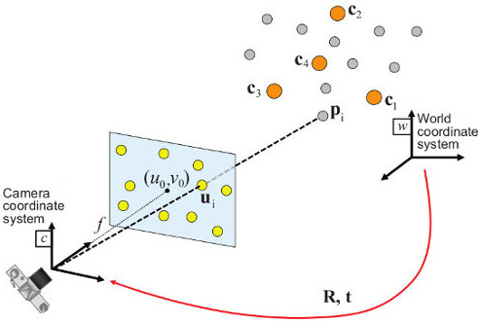
Motivation: Visual Landing System (VLS)
An ambition : to create an AI-based autonomous system that ensures a safe landing.
Pilot support
1. Runway Detection
2. 2D Keypoints extraction
3. Pose estimation
Keypoints Features Extraction
Input Image
Crop
⇒ This research industrial use case is being studied by a diverse range of institutes and companies, including Airbus (ATTOL, A³), Boeing, Daedalean, and various Chinese research organizations.
Notes:
Le système doit respecter des contraintes computationnelles strictes (20 images par seconde sans recours à un GPU), garantir une robustesse face aux conditions opérationnelles difficiles, et offrir une explicabilité suffisante pour répondre aux exigences de certification.

Slide 3
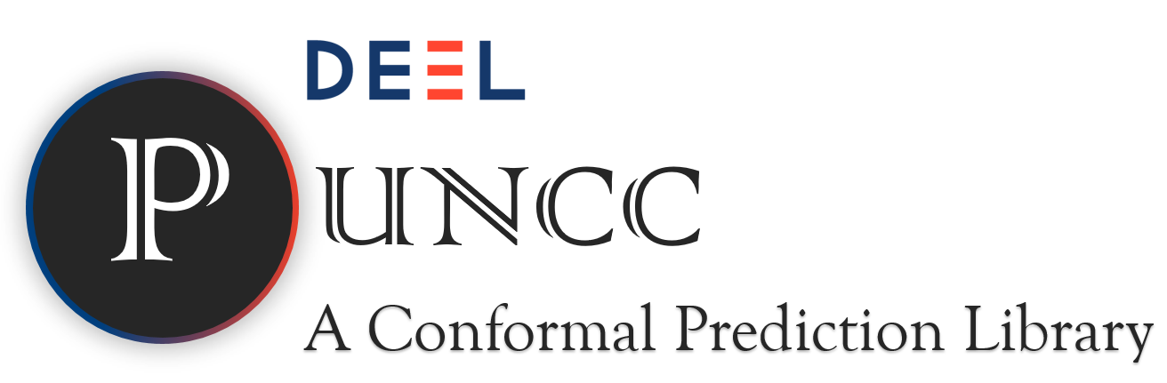
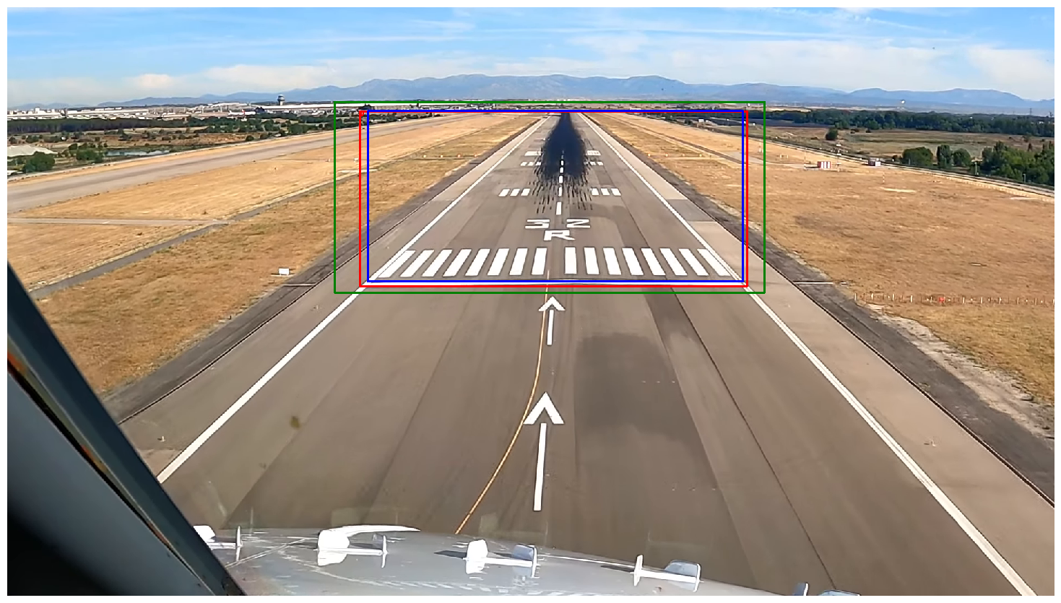

Our Contributions
Application of Conformal Prediction (CP) ⇒ allows uncertainty quantification for Runway Detection using PUNCC library. ⇒ Ensures statistical guarantees.
Conformal Mean Average Precision (C-mAP): ⇒ introduce C-mAP, a novel metric combining performance & robustness evaluation.
Open-Source Contribution: ⇒ codebase & trained models on , to promote reproducibility and encourage further research in this area. (e.g conformal_runway_detection on git)
Our Repository : https://github.com/alyasltd/conformal_runway_detection
Notes:
About our solution and contributions, we applied CP on this use case using the PUNCC library.
Then we introduce a new metric called C-mAP in order to evaluate object detection and robustness.
And finally, all our results are open source to encourage further research in the area.

Slide 4
VLS pipeline
An ambition : to create an AI-based autonomous system that ensures a safe landing.
Pilot support
1. Runway Detection
2. 2D Keypoints extraction
3. Pose estimation
Keypoints Features Extraction
Input Image
Crop
Computational constraints :⋍20 frames per second + no GPU
Robustness to difficult conditions and explainability for certification.
Certification in compliance with EASA standards
Notes:
Le système doit respecter des contraintes computationnelles strictes (20 images par seconde sans recours à un GPU), garantir une robustesse face aux conditions opérationnelles difficiles, et offrir une explicabilité suffisante pour répondre aux exigences de certification.

Slide 5
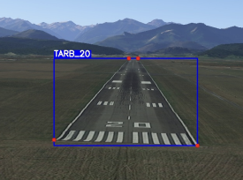
Quick Object Detection Overview
What’s YOLO ?
Identify and localize objects within an image
Classify them into predefined categories
Single-stage detector : directly predict bounding boxes and class probabilities for each object in a single pass through the network
⇒ low run-time & accuracy
О = Objectness Score "Is there something here?" score - Used to quickly filter out background areas.
Relative center (𝑥,𝑦)
𝑝_{runway}= Class Probability "What is it?" score that represents the probability of the object belonging to a particular class.
Width and Height (𝑤,𝒽)
о, 𝑝_{runway}
Confidence-score = о ✕ 𝑝_{runway}​ ⇒ “proxy for uncertainty estimation”
Redmon et Al, CVPR 2016 - Li et al. 2023
Notes:
For those who are not really familiar with object detection model, I wanted to do a quick overview on the topic and especially YOLO.
YOLO or You Only Look Once is an object detection model that allows to identify and localize object within an image. It also classify the detected objects
into predefined categories.
The particularity about YOLO is that it’s a single stage detector, which mean that it directly predicts the BBox and class probabilities for each detected object in a single pass through the network. This makes YOLO a low run-time model and provides very good accuracy.
An output tensor of YOLO looks in general like this *I show the tensor*, we have xywh which are the Bbox normalized coordinates of the XY center of the box and it’s height and width. Then YOLO computes the objectness score, it’s like a probability to indicate the presence of this object in the image, and finally we have the class probabilities vector.
If we have n classes to detect then the vector will be n probabilities long. But in our case, we only detect the runway.
Last, but not least, in general we can compute the confidence-score which can be seen as a proxy for uncertainty estimation in the literature but it doesn’t provide statistical guarantees.

Slide 6
How to evaluate ONE box prediction: What’s IoU & IoA ?
😀
Good IoU !
😡
Bad IoU and IoA !
😀
Good IoA !
⇒ Greater the ground truth is covered by the prediction, the closer IoA is to 1.
⇒ Value between 0 and 1
⇒ Greater the overlap, the closer IoU is to 1.
⇒ Value between 0 and 1
+
-
Notes:
Here we focus on How to evaluate one box prediction and so we’ll be talking about IoU and IoA.
IoU (Intersection over Union) is a metric that evaluates the overlap between the predicted box and the GT box. The range of value is between 0 and 1 and the greater the overlap is the closer IoU is to 1.
IoA on the other hand, evaluate the GT box area covered by the predicted box. It’s also between 0 and 1 and the greater the GT is covered the closer IoA is to 1.
Here you have example of good IoU and IoA and a bad example.

Slide 7
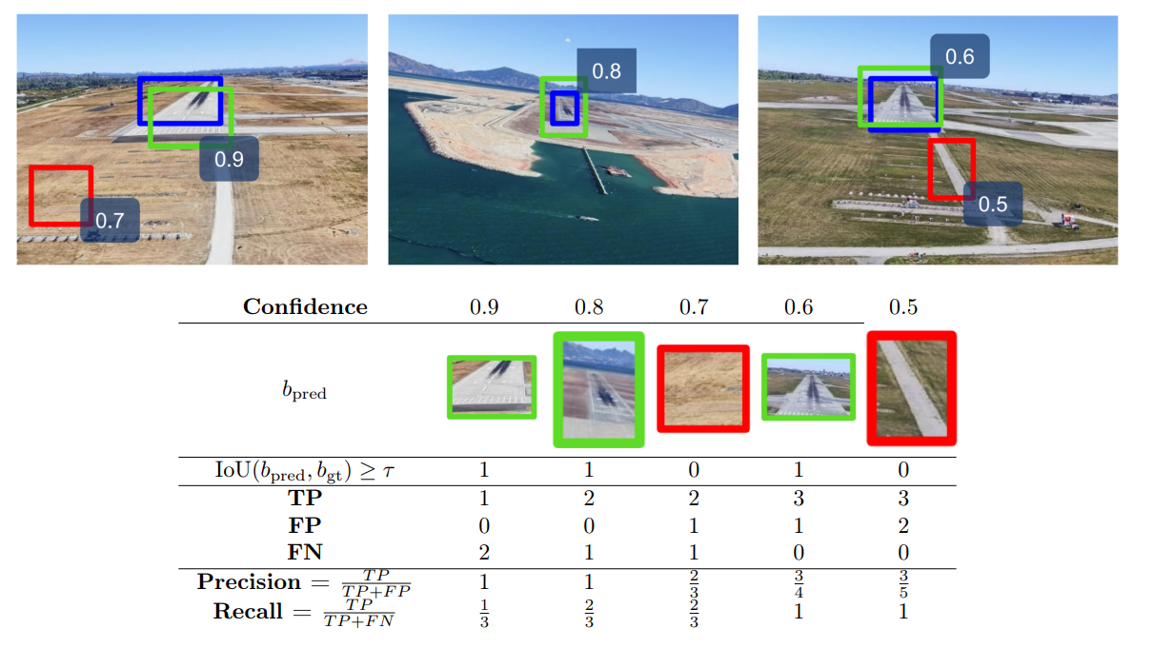
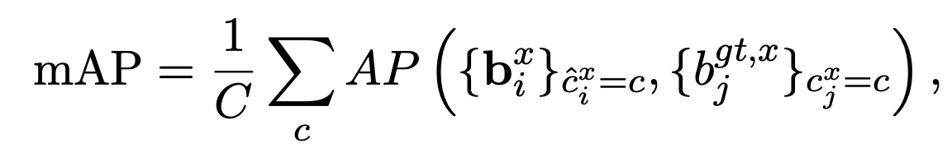

How to evaluate Object Detection accuracy ?
Mean Average Precision (mAP) - YOLO’s evaluation of average precision across all classes
⇒ between 0 (very bad overlap) and 1 (perfect overlap)
Number of classes - here 1
GT
Metric to evaluate the matching - IoU
per class
Predicted Boxes with highest probabilities
⇒ mAP = AP cause we’ve got 1 class only
Notes:
So our goal here is to adapt the AI model responsible for the detection a posteriori so that the predicted bounded boxes cover the GT with statistical guarantees.
As you can see here, this is what we want, in blue cyan we have the BBox originally computed by the object detector, then in red the GT and finally in orange the conformalized box that will be an improvement of the blue one.
In order to achieve that, we’ll apply conformal prediction on the object detection model’s output using the PUNCC library.
And we need to evaluate how the conformalization affects performance using dedicated, industrially relevant metrics.

